Slide 1

Theory of Automata & Formal Languages CS-224
Sir Syed University of Engineering & Technology, Karachi

Slide 2
Transection Graph
A transition graph, abbreviated TG, is a collection of three things:
1. A finite set of states at least one of which is designated as the start state (-)
and some or one of which are designated as final states (+).
2. An alphabet of possible input letters from which input strings are formed.
3. A finite set of transitions that show how to go from one state to another
based on reading specified substrings of input letters
(possibly even the null string ^ ).

Slide 3
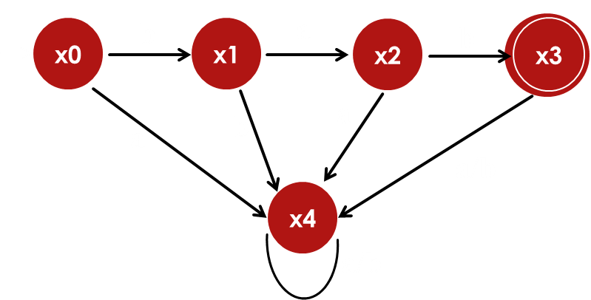
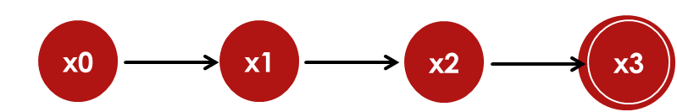
Transection Graph
A DFA that accept bab string.
A NFA that accept bab string.
A TG that accept bab string.
x1
b
ab
x0
ba
x1
b
x3
x0
x4
ba
b
x2
b
ab
x0
bab
x4
^
bab
x2
x3

Slide 4
DFA to RE
Eliminate State Methods:
x0
a/b
x1
a/b
x2
1. Convert the DFA into NFA
2. Eliminate all sates between
initial and final One by One.
a/b
x3
a/b
x0
a/b
x1
a/b
x2

Slide 5
DFA to RE
Eliminate State Methods:
x0
a/b
x1
a/b
x2
1. Convert the DFA into NFA
2. Eliminate all sates between
initial and final One by One.
a/b
x3
x0
a+b
x1
a+b
x2
a/b
x0
a/b
x1
a/b
x2
x0
(a+b)
(a+b)
x2
RE = (a+b)(a+b)

Slide 6
a
x0
a+b
x1
x0
x1
RE = a+b
b
a
b
x0
a*
b
x1
RE = a* b
x0
x1

Slide 7
a
a
a,b
a
a,b
a*
b
x1
b
x2
x0
b
x1
b
x2
x0
a,b
a,b
a
a*
a*
a*
b
b
x2
x0
b
x1
b
x2
x0
x1
a*
a*
(a+b)*
a*
a*
(a+b)*
b
b
x2
x0
b
x1
b
x2
x0
x1
a*
(a+b)*
b
a*
a*
a*
(a+b)*
x0
b
x2
x0
b
x1
b
x2
RE = a*ba*b(a+b)*

Slide 8
a
x0
x1
a (ba)*
x0
x1
RE = a
*
(ba)
b
a
ᵋ
*
RE = (ab)*
x0
x1
RE =
(ab)
b

Slide 9
a*b* = (a+b)*
(ab)* = (a+b)*
(a*)* = a*
(a* + b*)* = (a+b)*
No
No
Yes
Yes

